Slide 1

CAPSTONE PROJECT PHASE A
PROJECT NO. 24-2-R-11
GENDER-BASED ANALYSIS OF BIOLOGICAL PATHWAYS
IN GENE EXPRESSION
SUPERVISOR: GUR ARYE YEHUDA
STUDENTS: MAAYAN AVITTAN
MOR SHMUEL
1
Notes:
Good morning/afternoon, everyone.
I'm Maayan Avittan (and I'm Mor Shmuel)
And today, we will be presenting our Capstone Project on Gender-Based Analysis of Biological Pathways in Gene Expression.
This research aims to uncover how gender differences influence gene expression, it is centered around the biological pathways that differ in gene expression between males and females.
this project is under the supervision of Gur Arye Yehuda.

Slide 2
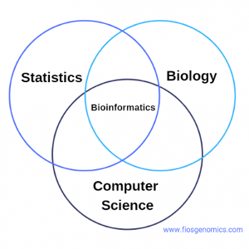
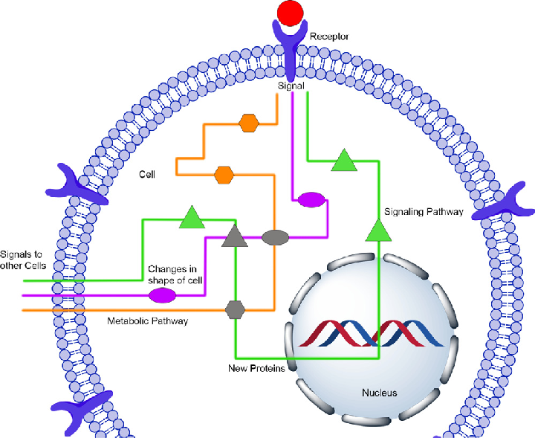
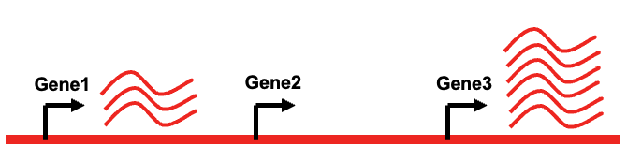
BACKGROUND
BIOINFORMATICS
Massive genomic data is generated and stored publicly
BIOLOGICAL PATHWAYS
Series of actions among molecules in a cell that lead to a specific outcome
GENE EXPRESSION
How the gene is expressed
2
Notes:
little background about the main concepts around our project:
Bioinformatics combines Biology, computer science, and statistics to analyze large genetic datasets. This field helps us make sense of complex gene expression data.
Biological Pathways are sequences of actions in a cell that lead to specific outcomes, like metabolism or immune responses.
Gene expression is how expressed the gene is – what it’s level.
(Gene Expression is the way the information from a gene is converted into cellular functions.)

Slide 3
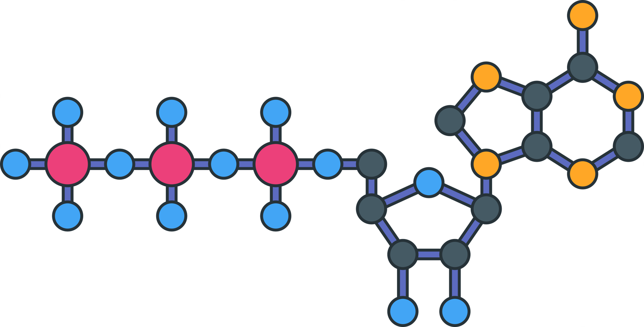
What are the underlying biological mechanisms that contribute to gender-specific differences in physiological processes?
RESEARCH
QUESTION
3
Notes:
The primary question we want to explore on this research is What are the underlying biological mechanisms that contribute to gender-specific differences in physiological processes?
So, we aim to answer not just ‘what genes are expressed differently,’ but also ‘what biological processes and pathways are affected by these sex differences.

Slide 4
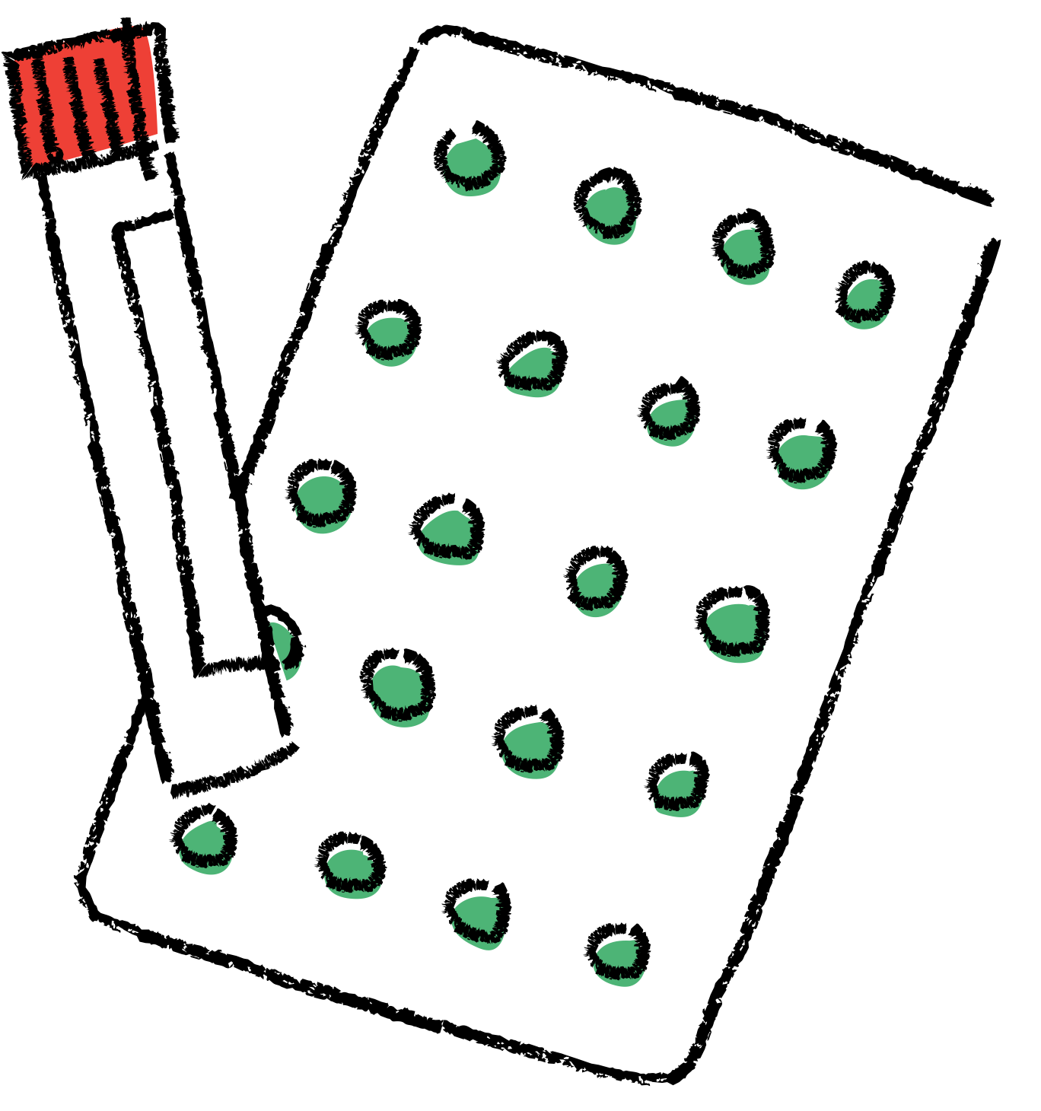

MOTIVATION
Importance of Biological pathways
Gender-Specific Disease Susceptibility
Personalized Medicine
4
Notes:
What is our motivation?
First, Biological pathways control essential cellular functions, from metabolism to immune responses, and differences in these pathways can explain why certain diseases affect males and females differently.
Second, how likely each gender is to get certain disease. For example, women are more prone to autoimmune diseases, while men have higher rates of cardio diseases.
Finally, the goal of personalized medicine is to adjust medical treatment to individual characteristics, and gender is a key variable.
------------------------------------------------------
A biological pathway is a series of actions among molecules in a cell that leads to a certain product or change in the cell. Pathways are critical for various biological processes, such as metabolism, gene regulation, and immune responses. Example: The glycolysis pathway involves a series of steps that break down glucose to produce energy for the cell.
Cellular function refers to the activities and processes carried out by cells to sustain life. Cells perform tasks like energy production, molecule transport, waste removal, and protein synthesis. Example: Protein synthesis is a critical cellular function, where cells use DNA instructions to create proteins, essential for structure and function.
Metabolism is the set of life-sustaining chemical reactions in organisms. These reactions break down nutrients (like sugars and fats) to produce energy or use energy to build molecules.
The immune response is the body's defense mechanism against foreign invaders, such as bacteria, viruses, and toxins. It involves recognizing and attacking these threats using specialized cells and proteins. Example: When a virus enters the body, the immune system produces antibodies to neutralize the threat.
In autoimmune diseases, the immune system mistakenly attacks the body’s own healthy cells, tissues, or organs. This can cause chronic inflammation and damage to various parts of the body.
The cardiovascular system involves the heart and blood vessels, responsible for circulating blood throughout the body to supply oxygen and nutrients while removing waste.

Slide 5


PREVIOUS WORK
MAYNE ET AL. (2016)
GERSHONI & PIETROKOVSKI (2017)
KASSAM ET AL. (2019)
OLIVA ET AL. (2020)
HARTMAN ET AL. (2021)
LOPES-RAMOS ET AL. (2020)
YEHUDA & SOMEKH (2022)
Showed sex differences in immune and energy pathways
Found sex-biased gene expression under evolutionary pressure
Identified tissue-specific sex differences influenced by hormones
Revealed 37% of genes exhibit sex-biased expression across tissues
Explored sex-dependent immune gene co-expression
Highlighted sex-biased transcription factor targeting in pathways
Applied machine learning to predict gene functions in fat tissue
5
Notes:
Research on sex-biased gene expression has expanded over the last decade, revealing key insights into how these differences affect health outcomes in males and females.
Mayne et al. (2016) discovered that immune pathways are more active in females, while growth and energy pathways are more active in males.
Gershoni & Pietrokovski (2017) studied gene expression in 53 tissues and found that sex-biased genes are influenced by evolution.
Kassam et al. (2019) Identified tissue-specific sex differences influenced by hormones
Oliva et al. (2020) showed that around 37% of genes are expressed differently in males and females.
Hartman et al. (2021) Explored sex-dependent immune gene co-expression.
Lopes-Ramos et al. (2020) showed that genes controlled by transcription factors work differently between men and women.
Yehuda and Somekh (2022) used machine learning to study gene functions in fat tissue, showing how bioinformatics and machine learning together can help us understand how genes work differently between men and women.
These studies give us a strong base for understanding sex-biased gene expression.

Slide 6
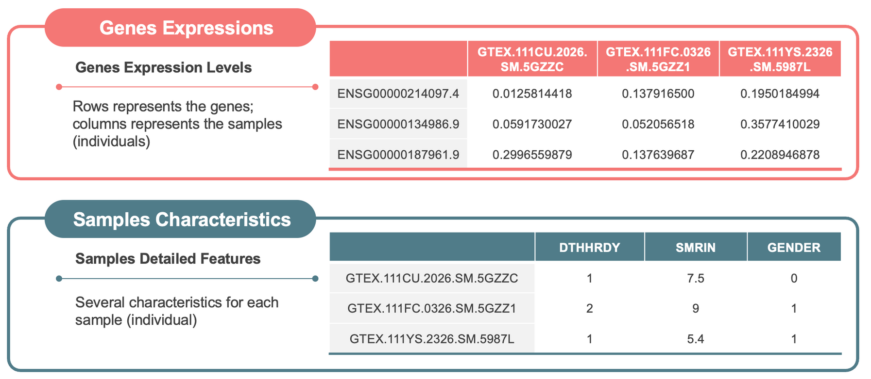
DATASET OVERVEIW
The GTEx dataset provides large-scale RNA sequencing data from multiple human tissues, allows us to explore gene expression differences across tissues and analyze the impact of gender on biological pathways
6
Notes:
Now let's talk about our Dataset that we are going to use, its the Gtex dataset which provides large-scale RNA sequencing data across multiple human tissues.
This is what our data looks like, the data includes the gene levels of the deceased people and several characteristics of the deceased.
In the upper table you can see rows that describe genes and columns are samples of the deceased people.
In the lower table you can see the characteristics of each subject, for example SMRIN represents the quality of the sample, GENDER describes the gender, DTHHRDY - the cause of death.
DTHHRDY = 0 cases on mechanical ventilator before death
DTHHRDY = 1 non-ventilation fast deaths due to accident, blunt force, trauma, or suicide of healthy individuals
DTHHRDY = 2 non-ventilation fast deaths of natural causes of healthy individuals
DTHHRDY = 3 represents intermediate death after terminal phase of 1 to 24 hours
DTHHRDY = 4 represents slow death after a long illness

Slide 7
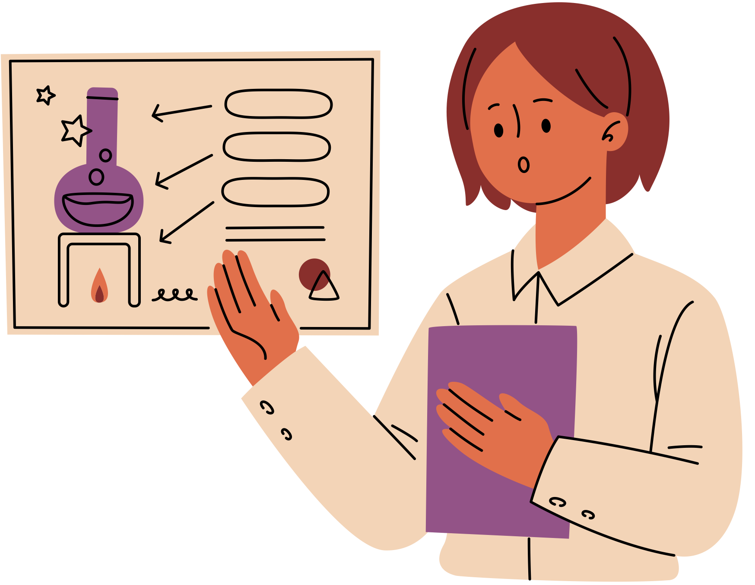
OUR HYPOTHESIS
Gender-specific gene expression influence biological pathways.
Gene expression data will show sex-biased expression patterns.
Enrichment analysis will reveal biologically meaningful gender-based pathways that could have implications for personalized medicine.
10
Notes:
Our hypothesis has three key points:
The first one is the Gender-specific gene expression and how it affects biological pathways, meaning that genes behave differently in males and females, which influences how biological processes work.
The second is The gene expression data that we are going to analyze and will show us sex-biased expression patterns, where certain genes are more active in one gender than the other.
The last one is Enrichment analysis it will help us find biologically meaningful gender-based pathways that could inform personalized medicine.

Slide 8

EXPERIMENTAL TOOLS
GTEx dataset
WGCNA
Machine learning models
Enrichment analysis
KEGG
11
Notes:
our key experimental tools include using the GTEx dataset, applying WGCNA technic to identify co-expression modules, and then using machine learning models.
We also use enrichment analysis to understand the biological relevance, using databases like KEGG to validate our results.
KEGG = (Kyoto Encyclopedia of Genes and Genomes) and show us biological pathways data.

Slide 9
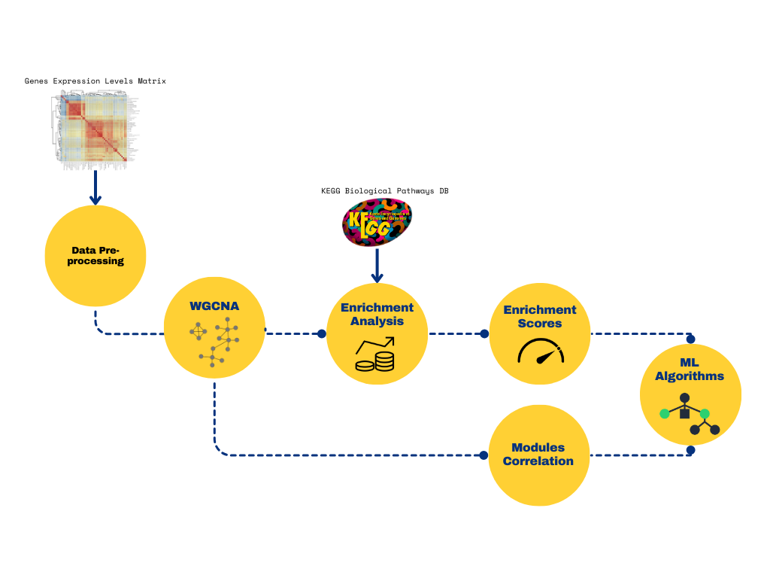
RESEARCH PLAN
12
Notes:
Now let’s see our research plan:
Step 1: Data Pre-processing
we want to clean the data, it is a very noisy data and we want to **(להוריד)remove all the errors and fixing the differences from how the data was collected
Step 2: WGCNA (Weighted Gene Co-Expression Network Analysis)
Which I’ll talk about on the next slide.
Step 3: Enrichment Analysis
Examine the gene groups to see how they connect to known biological pathways using KEGG DB.
The outcome of this step is the enrichment scores, meaning that every group of genes get a score depend how strongly they linked together.
Step 4: Modules Correlation
in the same time we want to apply modules correlation on the groups we get after the WGCNA step, we want to Compare gene groups with gender to find pathways that are influenced by sex.
Step 6: ML Algorithms
And the last step is to Use machine learning models to predict and validate gender-influenced pathways and improving the accuracy.

Slide 10
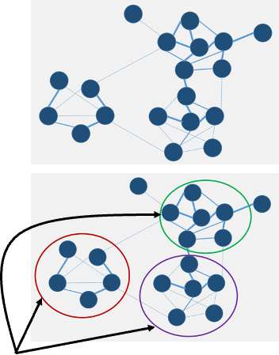

Weighted Gene
Co-Expression Network Analysis
Central Hypothesis -
Genes with similar expression patterns are of interest because they may be
• Tightly co-regulated
• Functionally related
• Members of the same biological pathway
Network -
Construct a gene-gene similarity network based on genes expression levels
Modules -
Divide network into modules (clusters)
7
Notes:
To analyze the gene expression data, we used WGCNA, which is a technique to identify clusters of co-expressed genes. The idea is to group together genes that have similar expression patterns.
We will start by analyzing gene expression levels across tissues. This data helps us see how genes are behaving—if they are active or inactive.
Using these expression levels, we will create a gene-gene similarity network which show us how similar the expression patterns of different genes are.
In this network, we then identify clusters (modules) of co-expressed genes. These modules give us insight into which genes work together in specific biological pathways.
WGCNA allows us to find groups of genes that might be regulated together or participate in the same biological pathway.
------------------------------------------------------
Gene expression refers to the process by which the instructions in a gene are used to synthesize a functional product, usually a protein. It is the way information from a gene is converted into cellular functions. Example: When a gene is expressed, it can produce proteins that carry out essential roles, like repairing cells or responding to external signals.
Co-expressed genes are genes that are turned on or off together across multiple samples. When the expression of two or more genes shows a similar pattern, they are considered co-expressed.
Expression patterns refer to the variation in how genes are turned on or off across different conditions, tissues, or individuals. These patterns can indicate whether genes are playing a role in specific biological processes or responding to external factors.
Expression levels refer to how much of a gene's product (usually mRNA) is present in a cell or tissue. It shows whether a gene is active or inactive, and how much it contributes to cellular functions.
A gene-gene similarity network is a representation of how similar the expression patterns of different genes are. In this network, genes are connected based on how similarly they behave across different samples. Genes with more similar expression patterns are connected more strongly.
A transcription factor is a special type of protein that helps control how genes are used in the cell. It acts like a switch, turning genes on or off by binding to specific spots on the DNA.

Slide 11

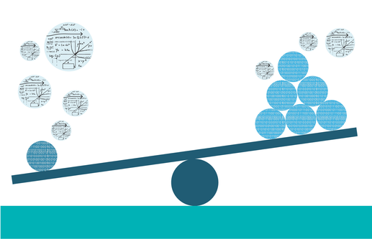
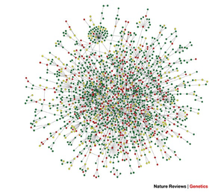
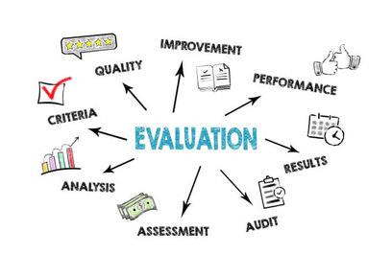
CHALLENGES
Data Preprocessing
WGCNA and Enrichment Analysis
Incomplete data
Batch Effects
Identifying Relevant Gene Modules
Sex-Biased Pathways
Ensuring Biological Relevance
ML Model Optimization
Validation
Fine-Tuning Models
Interpreting Model Outputs
9
Notes:
In Phase 2, we’ll face several challenges:
Data Preprocessing: We’ll need to handle missing data like I've talked before, and we need to handle Batch effects that can hide real signals. We’ll also identify and remove outliers that could twist our results.
WGCNA and Enrichment Analysis: Identifying Relevant Gene Modules and Sex-Biased Pathways it is a very big challenge, and we need to identify it carefully
Machine Learning Optimization: We need to fine-tune models to predict pathways accurately, avoiding overfitting.
Validation: Finally, we’ll need to verify the biological relevance of identified pathways by cross-referencing with KEGG and current literature.
------------------------------------------------------
Batch effect refers to differences in data that arise due to variations in how or when samples were collected, processed, or analyzed, rather than from actual biological differences. For example, if RNA samples were processed on different days or with different machines, these technical differences might affect the results.
Outliers are data points that are significantly different from the rest of the data. In gene expression data, outliers can occur due to measurement errors or unusual biological events. These extreme values can distort the results of the analysis if not properly handled.
Enrichment analysis is a method used to determine if certain genes, identified in an experiment, are over-represented in known biological pathways or functions. It helps to identify which biological processes or pathways the co-expressed genes (from WGCNA) are involved in.
XGBoost: It works by building a series of decision trees that improve on each other, making it highly accurate for structured data.
SVM: This model works by finding the best boundary (or hyperplane) that separates different classes of data.
Hyperparameters are settings or configurations in a machine learning model that need to be fine-tuned to improve the model's performance. They control how the model learns from the data.
KEGG is a biological database that contains information about genes, proteins, and biological pathways. It is used to understand how genes are linked to specific biological functions or diseases.

Slide 12

EVALUATION PLAN
01
02
03
LITERATURE-BASED VALIDATION
CROSS-REFERENCING WITH DATABASES
EXPERIMENTAL CONSISTENCY
Compare the results with known pathways
Use pathway databases like KEGG to validate the pathways identified by the ML models
Ensure that predicted pathways align with known experimental data
13
Notes:
To evaluate the accuracy of our results, we will use several validation methods.
The First one, literature-based validation: we compare our findings with known biological pathways from previous studies.
Next, We will use pathway databases like KEGG for cross-referencing and verifying our predicted pathways.
Finally, we check for experimental consistency, ensuring our findings align with existing experimental data.

Slide 13
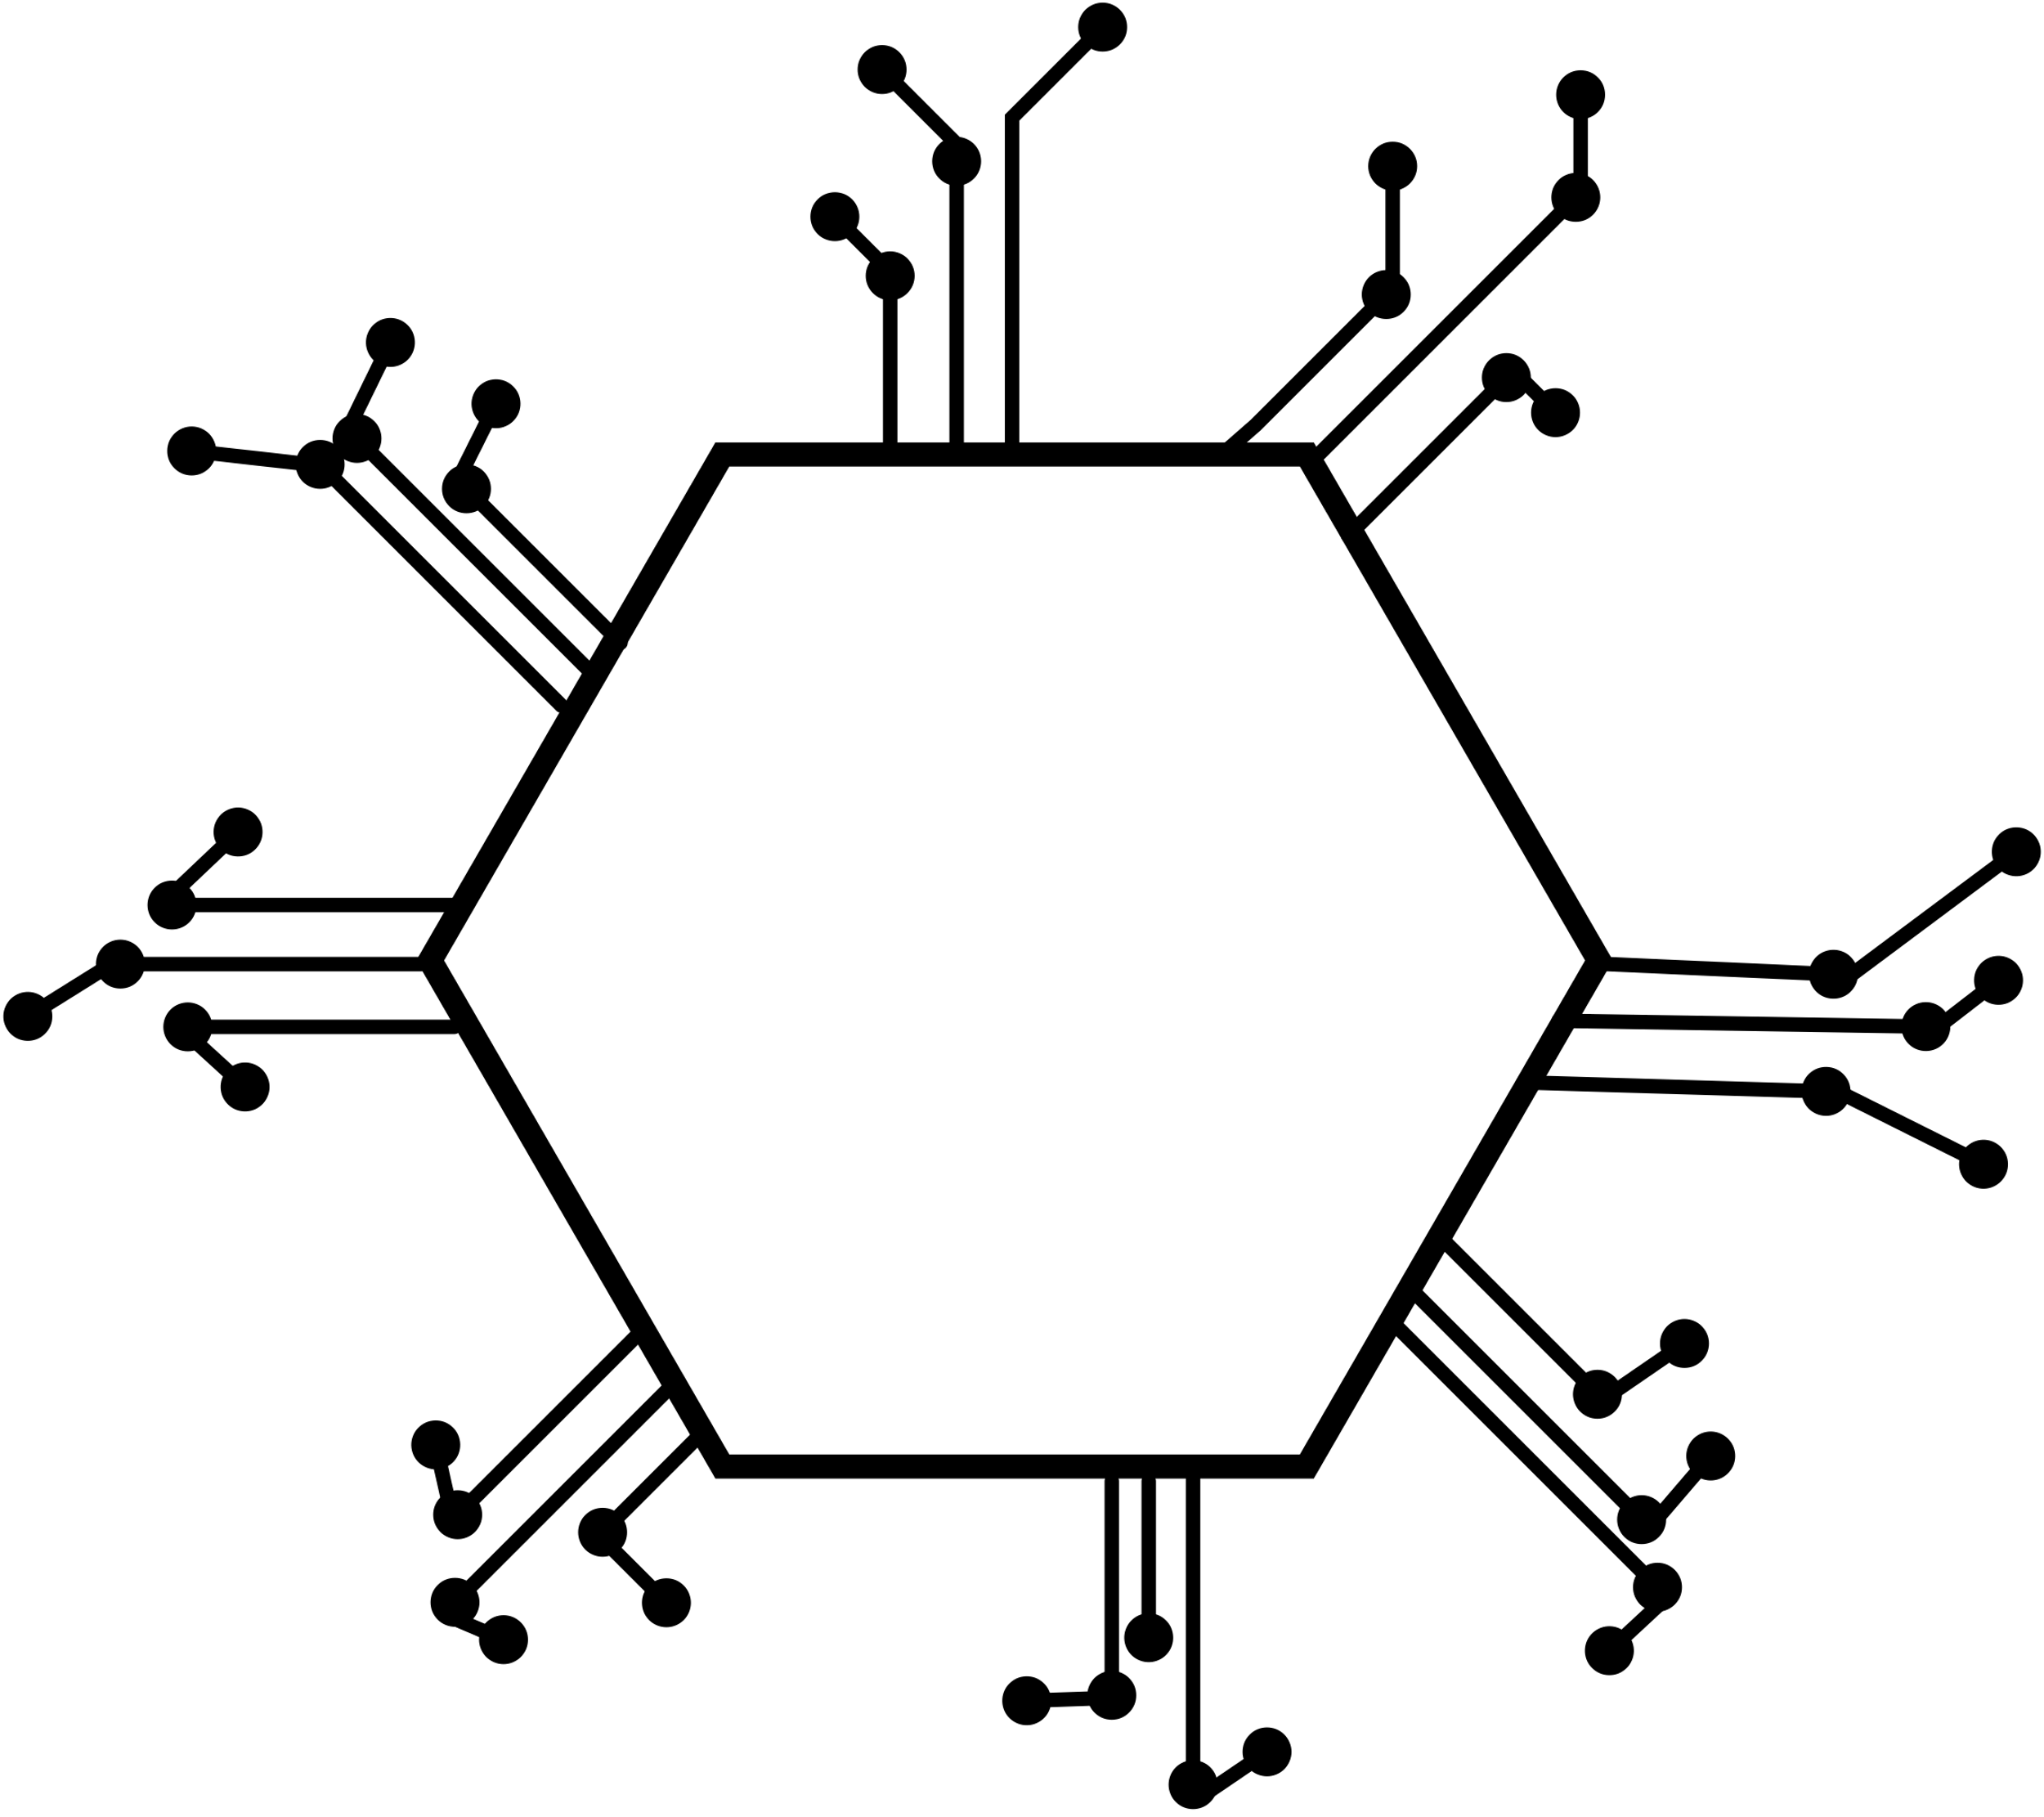

Expanding the understanding of gender-specific biological pathways in gene expression.
Leveraging machine learning models to predict pathways with sex-biased expression.
Identifying new patterns of sex-biased regulation in tissues.
OUR
CONTRIBUTION
8
Notes:
our contribution from this study is to expand the understanding of gender-specific biological pathways by applying machine learning models to predict our needed pathways.
This research goal is to uncover patterns of gene expression that have not been examined yet, hopefully leading to more specific treatments and a deeper understanding of gender-specific disease mechanisms.
------------------------------------------------------
Sex-biased expression refers to when certain genes are expressed (turned on or off) differently in males and females. This means that the amount of gene activity—how much mRNA or protein is produced—varies based on sex. These differences can affect biological processes and can contribute to why some diseases are more common in one gender. Example: Immune system genes might be more active in females, while growth-related genes might be more active in males.
Gene regulation is the process by which a cell controls the activity of its genes—whether genes are turned on or off, and how much of a gene’s product (like a protein) is made. This control is important for cells to respond to changes and to carry out their specific functions. Example: Hormones like estrogen or testosterone can regulate genes by turning them on or off in different tissues, such as reproductive tissues.

Slide 14


FUTURE WORK
Extension of Data Sources and Tissues Studied
Improve Machine Learning Models
Impact on healthcare and customized treatments
14
Notes:
This research opens opportunities for us and others to explore more.
Expanding to more diverse datasets would offer a broader understanding of sex-biased gene expression across populations.
also, using new machine learning models can enhance prediction accuracy.
finally, this research can guide the development of specific treatments that account for gender differences, improving medical outcomes for both males and females.

Slide 15

QUESTIONS?
THANK YOU
15
Notes:
Thank you for your attention. any questions?

Slide 16
REFERENCES
Anderson, W. D., Soh, J. Y., Innis, S. E., Dimanche, A., Ma, L., Langefeld, C. D., Comeau, M. E., Das, S. K., Schadt, E. E., Björkegren, J. L. M., & Civelek, M. (2020). Sex differences in human adipose tissue gene expression and genetic regulation involve adipogenesis. Genome Research, 30(10), 1379–1392.
Blencowe, M., Chen, X., Zhao, Y., Itoh, Y., McQuillen, C. N., Han, Y., Shou, B. L., McClusky, R., Reue, K., Arnold, A. P., & Yang, X. (2022). Relative contributions of sex hormones, sex chromosomes, and gonads to sex differences in tissue gene regulation. Genome Research.
Fisher, J. L., Clark, A. D., Jones, E. F., & Lasseigne, B. N. (2023). Sex-biased gene expression and gene-regulatory networks of sex-biased adverse event drug targets and drug metabolism genes. Cold Spring Harbor Laboratory.
Gautam, Y., Afanador, Y., Abebe, T., López, J. E., & Mersha, T. B. (2019). Genome-wide analysis revealed sex-specific gene expression in asthmatics. Human Molecular Genetics, 28(15), 2600–2614.
Gershoni, M., & Pietrokovski, S. (2017). The landscape of sex-differential transcriptome and its consequent selection in human adults. BMC Biology, 15(1).
Hartman, R. J. G., Mokry, M., Pasterkamp, G., & den Ruijter, H. M. (2021). Sex-dependent gene co-expression in the human body. Scientific Reports, 11(1).
InanlooRahatloo, K., Liang, G., Vo, D., Ebert, A., Nguyen, I., & Nguyen, P. K. (2017). Sex-based differences in myocardial gene expression in recently deceased organ donors with no prior cardiovascular disease. PLOS ONE, 12(8), e0183874.
Kassam, I., Wu, Y., Yang, J., Visscher, P. M., & McRae, A. F. (2019). Tissue-specific sex differences in human gene expression. Human Molecular Genetics, 28(17), 2976–2986.
Kurt, Z., Barrere-Cain, R., LaGuardia, J., Mehrabian, M., Pan, C., Hui, S. T., Norheim, F., Zhou, Z., Hasin, Y., Lusis, A. J., & Yang, X. (2018). Tissue-specific pathways and networks underlying sexual dimorphism in non-alcoholic fatty liver disease. Biology of Sex Differences, 9(1).
Yehuda, G. A., & Somekh, J. (2022). A methodology for classifying tissue-specific metabolic and inflammatory receptor functions applied to subcutaneous and visceral adipose. PLOS ONE, 17(10).
16
Notes:
These are the key references that have informed our research, including studies on sex-biased gene expression, machine learning applications in biology, and the GTEx dataset.

Slide 17
Li, X., Su, X., Liu, J., Li, H., Li, M., Li, W., & Luo, X.-J. (2021). Transcriptome-wide association study identifies new susceptibility genes and pathways for depression. Translational Psychiatry, 11(1).
Liuzzo, G., & Galiuto, L. (2020). Ubiquitous sex differences in tissue gene expression: The dawn of a new era for gender medicine. European Heart Journal, 41(42), 4090–4091.
Lopes-Ramos, C. M., Chen, C.-Y., Kuijjer, M. L., Paulson, J. N., Sonawane, A. R., Fagny, M., Platig, J., Glass, K., Quackenbush, J., & DeMeo, D. L. (2020). Sex differences in gene expression and regulatory networks across 29 human tissues. Cell Reports, 31(12), 107795.
Mayne, B. T., Bianco-Miotto, T., Buckberry, S., Breen, J., Clifton, V., Shoubridge, C., & Roberts, C. T. (2016a). Large scale gene expression meta-analysis reveals tissue-specific, sex-biased gene expression in humans. Frontiers in Genetics, 7.
Mayne, B. T., Bianco-Miotto, T., Buckberry, S., Breen, J., Clifton, V., Shoubridge, C., & Roberts, C. T. (2016b). Large scale gene expression meta-analysis reveals tissue-specific, sex-biased gene expression in humans. Frontiers in Genetics, 7.
Oliva, M. (2020). The impact of sex on gene expression across human tissues. Science.
Saha, E., Guebila, M. B., Fanfani, V., Fischer, J., Shutta, K. H., Mandros, P., DeMeo, D. L., Quackenbush, J., & Lopes-Ramos, C. M. (2023). Gene regulatory Networks Reveal Sex Difference in Lung Adenocarcinoma. Cold Spring Harbor Laboratory.
Sousa, A., Ferreira, M., Oliveira, C., & Ferreira, P. G. (2020). Gender differential transcriptome in gastric and thyroid cancers. Frontiers in Genetics, 11.
Morrow, E. H. (2015). The evolution of sex differences in disease. Biology of Sex Differences, 6(1).
Arye Yehuda, G., Somekh, J. (2022) A methodology for classifying tissue-specific metabolic and inflammatory receptor functions applied to subcutaneous and visceral adipose.
Khodursky, S., Jiang, C. S., Zheng, E. B., Vaughan, R., Schrider, D. R., & Zhao ,L. (2022). Sex differences in interindividual gene expression variability across human tissues. PNAS Nexus, 1(5).
17

